Slide 1

Containers Everywhere! Azure & Hyper-V Container Scenarios & Solutions

Slide 2
Containers Everywhere! Azure & Windows Container Scenarios & Solutions

Slide 3



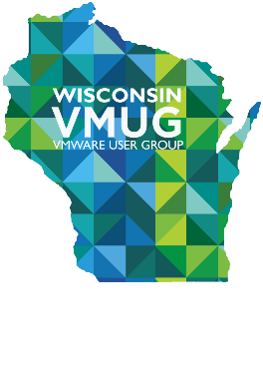
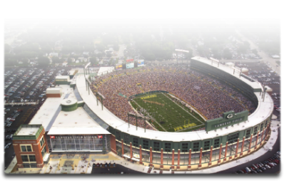

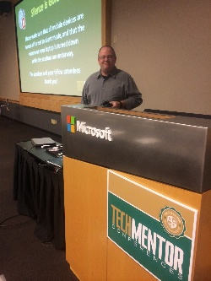

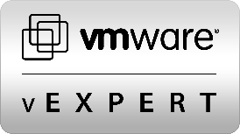



OWNER

Slide 4
Discuss
Containers & Docker
Azure, Windows, and Hyper-V containers
Managing
Why Windows?
Let’s do some demo

Slide 5
A (really) Brief History of Containers
1960’s
Mainframe
1979
Chroot in Unix V7
1990-2000+
BSD Jails, Solaris Zones
Linux Vserver
2006
Process Containers
2008
LXC
2013
Docker
2014
Rocket

Slide 6
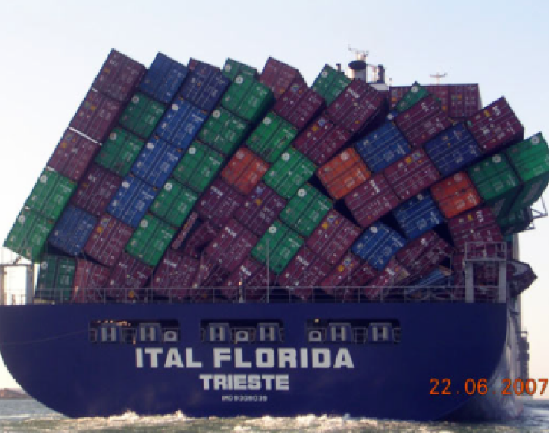
What are Containers?
Containers are Operating System-level Virtualization.
Containers encapsulate applications into individual isolated environments on a shared operating system with their own processes, network, binaries, and libraries.
Docker is a container technology. It is also a management, API, and packaging platform for containers.
Notes:
High level = Containers are lightweight VM’s
Low level – chroot on steroids

Slide 7
“
It’s about the applications
“

Slide 8
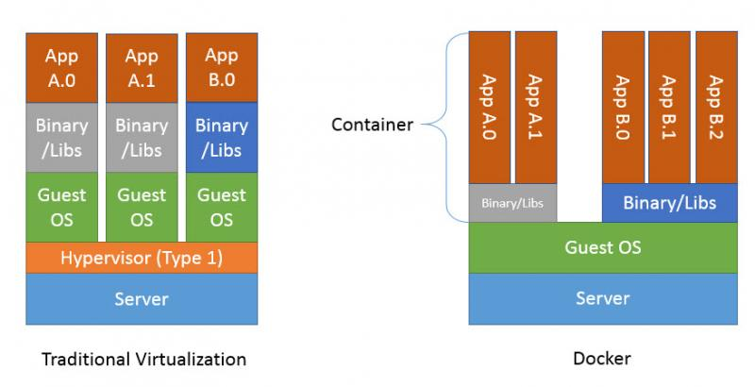
VM’s VS Containers
Notes:
Containers = almost no overhead, processes from on the host, memory/disk/COU a minimal besides app load
Uses copy-on-write storage

Slide 9
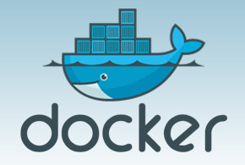

What is Docker?
“
Docker is a runtime for Linux Containers. It enables "separation of concern" between devs and ops,
“
Jerome Petazzoni – “Tinkerer Extraodinaire” at Docker

Slide 10
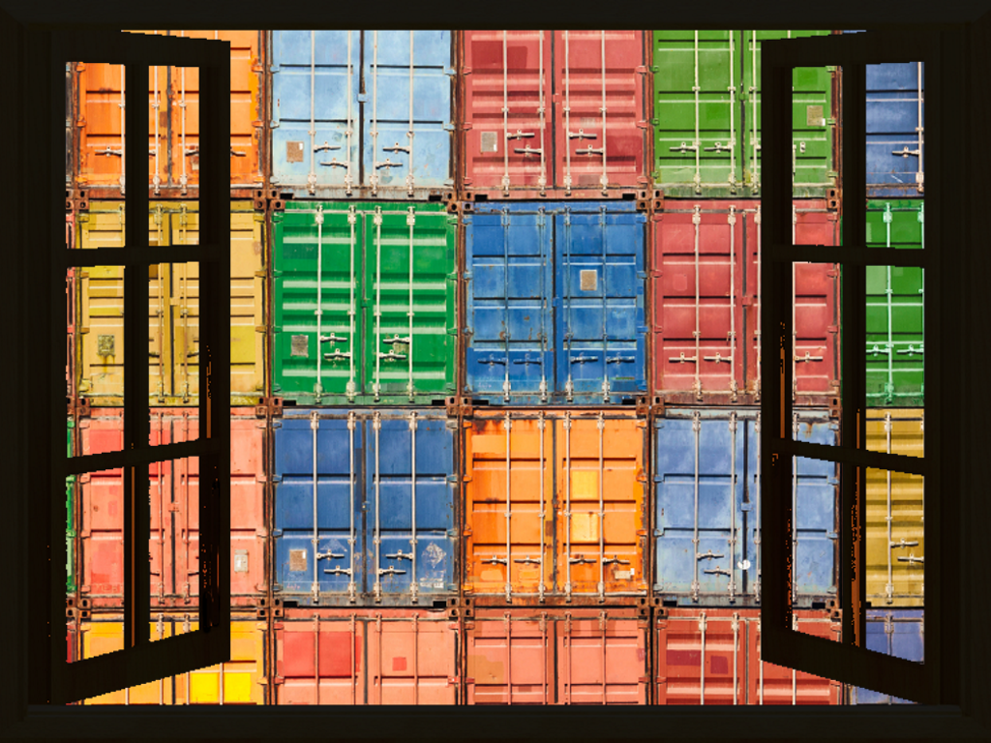
Opening Windows to Containers
Linux-
Azure support for Linux Containers
Windows Docker Toolbox (OS X, WIN)
Windows-
Windows Docker Machine (VirtualBox)
Windows Containers
Hyper-V Containers
PowerShell for Containers
Look for portability between platforms

Slide 11
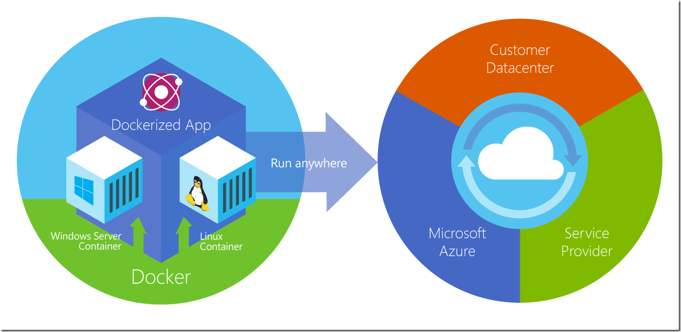
How Azure Sees It

Slide 12
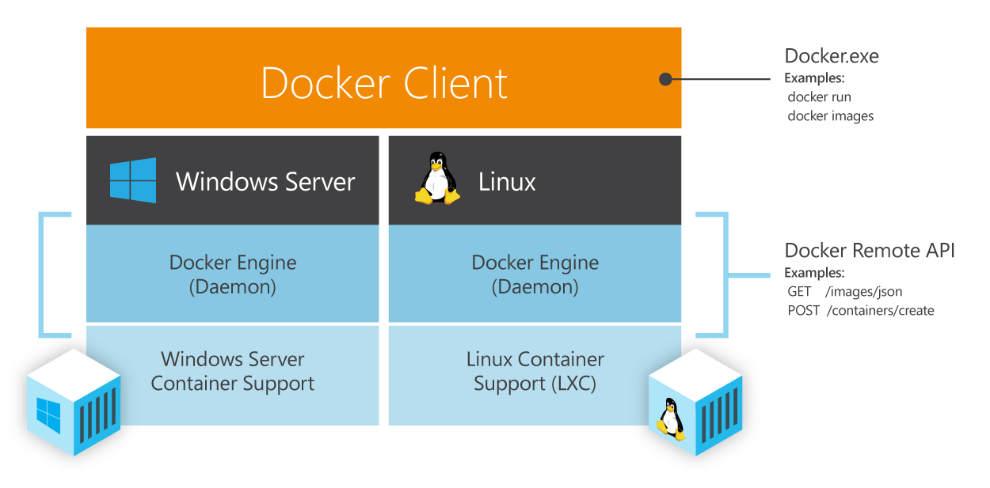
Not Much Difference Between Windows & Linux… Except the Obvious

Slide 13
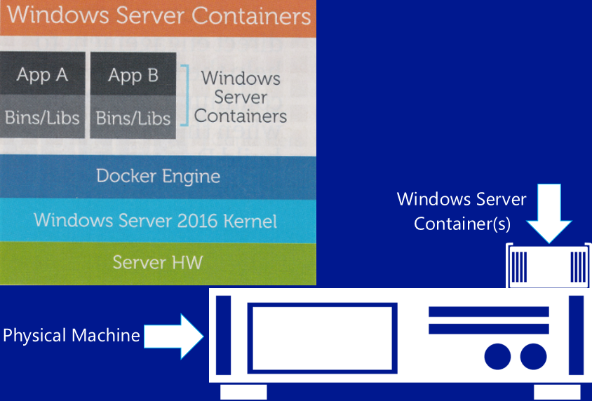
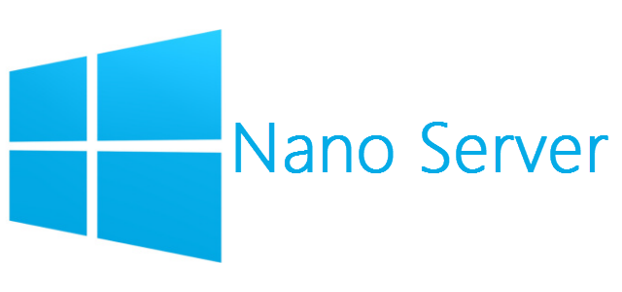
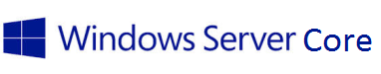
Architecture of a Windows Container

Slide 14
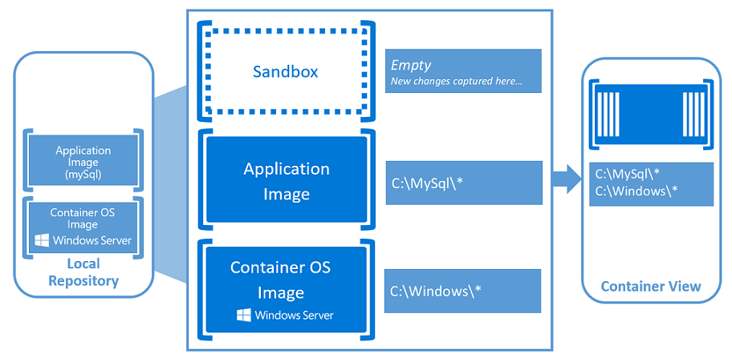
App Example in a Windows Container

Slide 15
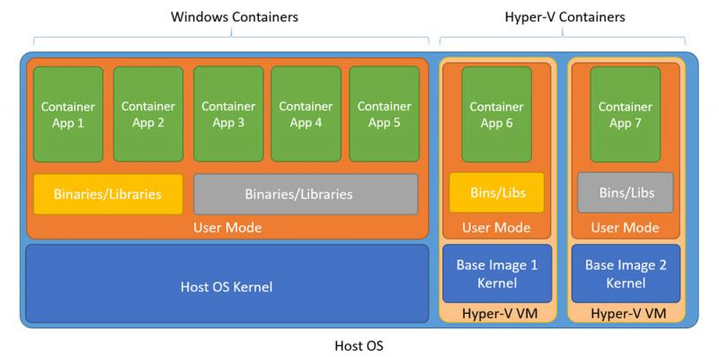
Differences Between Windows & Hyper-V Containers

Slide 16
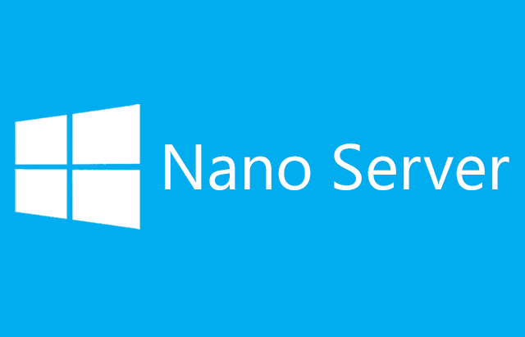
0.000.000.001
No login
No GUI
No RDP
No 32bit support
No MSI installer
One Billionth
WMI / PowerShell / DSC / …more
Patches - < twice a year (Hmm)
Fast boot
Core? Oh yeah, it’ll stick around

Slide 17
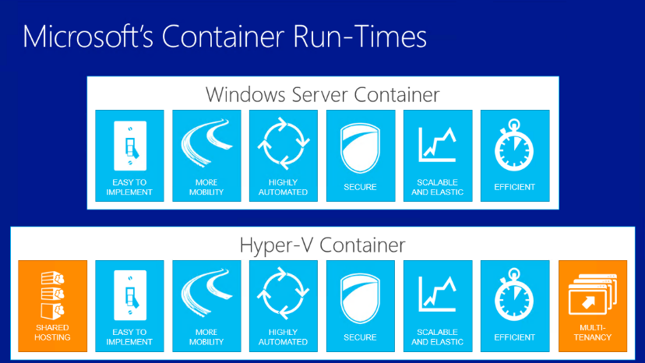
When the Same is not the Same

Slide 18
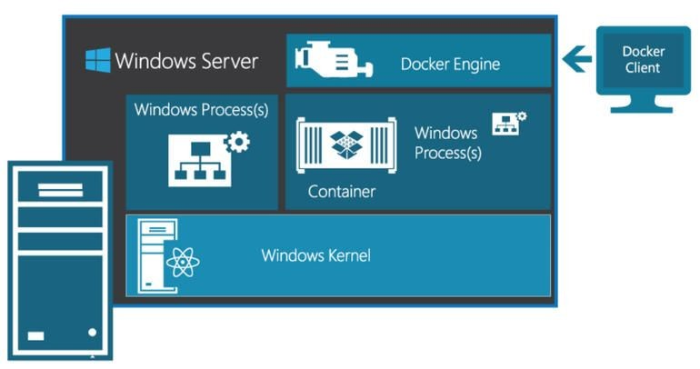
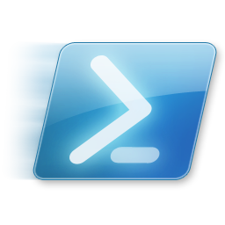
How It All Stacks Up in Windows

Slide 19
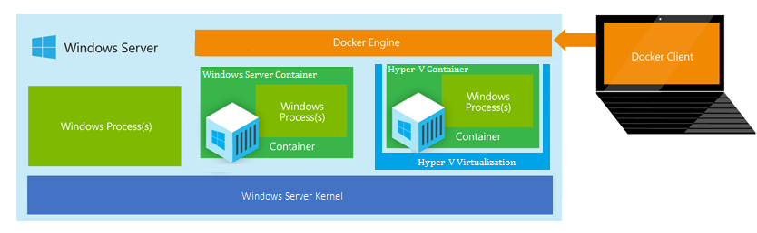
….As Well as Hyper-V

Slide 20
Choose Your Weapon of Choice
Compatible
Hint: PoSH is just getting it’s training wheels
https://msdn.microsoft.com/en-us/virtualization/windowscontainers/reference/ps_docker_comparison

Slide 21
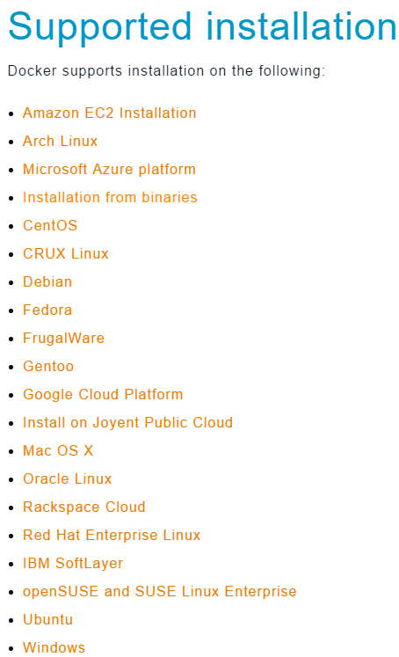
The Many Ways to Docker Containers & Client
Linux & Windows
Azure Linux Extension
Create a VM from Azure Gallery
Azure Marketplace
Install Docker Tookbox & Git (Win) or Docker Machine (Linux)
Azure CLI
Azure Templates
Visual Studio Extension
Kitematic
Vagrant
PowerShell
Server Role
… and more
Chocolately

Slide 22


Slide 23
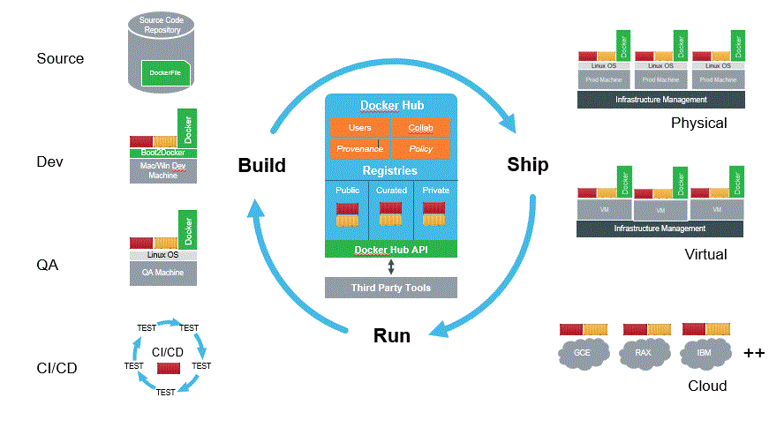
Repositories (Registries – “Hub”)
Push, Pull, Share, and Store
Official ones:
Hub
MySQL
mongoDB
PostgreSQL
Rails
Ruby
Java
WordPress
Redis
nGinx
Node
Ubuntu
Debian
CentOS
….. More

Slide 24
+
Azure
Cloud
Pre-built Images
Windows
Kernel
Libraries
Hyper-V
Multi-Tenant
Many Options
Cross-boundaries
Wide distribution
API’s
Cloud / Hybrid / On-Prem
Skillset
Shared Hosting
Security (nano)
Linux or Windows
Speed
Flexibility

Slide 25
-
Azure
Cloud
Windows
Kernel
Libraries
Hyper-V
Management
Too Many Options
Security
API’s
Versions
Not quite there yet
Frustrated admins with nano
Windows
Sprawl
Slow management
Patches

Slide 26
Reading Material & Links
Windows Containers https://msdn.microsoft.com/en-us/virtualization/windowscontainers/containers_welcome
Windows Container Docs on Github https://github.com/Microsoft/Windows-Container-Documentation
Azure with Docker https://azure.microsoft.com/en-us/documentation/articles/virtual-machines-docker-machine/
The TP3 Container Image http://bit.ly/1TUXjJa
Quick Start https://msdn.microsoft.com/en-us/virtualization/windowscontainers/quick_start/manage_docker
Work In Progress https://msdn.microsoft.com/virtualization/windowscontainers/about/work_in_progress

Slide 27
DEMO

Slide 29
謝謝
Tusind tak
Cheers!
Dank u zeer
THANK YOU!
Obrigado
Merci
Grazie
ﺷﻜﺮﺍ
Gracias

